Slide 1
Giới thiệu sản phẩm nội soi parcus - anika

Slide 2

Parcus Acquisition – anika mua lại parcus
Anika mua lại Parcus Medical LLC – 01/2020
Về công ty Parcus:
  Thành lập năm 2007
  Các sản phẩm nội soi:
      Nội soi vai - Shoulder
      Gối - Knee
      Háng - Hip
      Kết hợp xương - Distal Extremities
  Sản phẩm được sản xuất tại Mỹ với chất lượng cao và luôn luôn cải tiến
  Có hơn 400 sản phẩm
  Có mặt tại hơn 40 quốc gia
Notes:
$35m + $60m

Slide 3
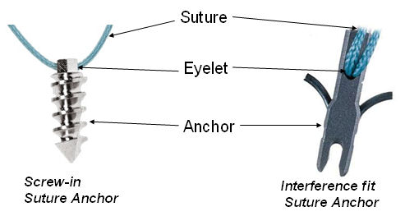
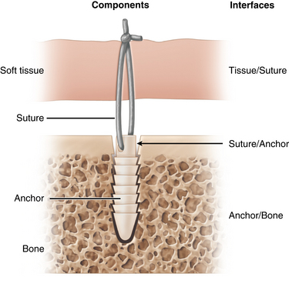
Vít chỉ neo - knotted anchors (Preloaded)
nội soi vai
Được sử dụng trong nhiều phẫu thuật khác nhau và là một trong những kiểu neo linh hoạt nhất.
Dùng trong:
  Tất cả các khớp
Vật liệu:
  Titanium
  PEEK
  PEEK CF
  Vít tự tiêu - Biocomposite (absorbable)
  Chỉ - All-Suture (soft)
Có thể lắp sẵn với:
  Chỉ - Suture
  Chỉ dẹt - Tape
Kích cỡ vít:
Mất vững - Instability sizes = 1.8mm – 3.5mm
Rách chóp xoay - Rotator cuff sizes = 3.2mm – 6.5mm

Slide 4
VÍt neo - Shoulder Anchors
Đa dạng - Wide variety
Kích thươcnsg từ 1,8mm đến 6,5mm - Sizes ranging from 1.8mm up to 6.5mm
Có chỉ, không chỉ và hỗn hợp - Knotted, knotless, hybrid
Chỉ số 2, chỉ dẹt 1,6mm, chỉ dẹt 2mm - #2 suture, 1.6mm suture tape, 2mm suture tape
Chất liệu:
  Titanium
  PEEK
  PEEK CF
  Biocomposite

Slide 5
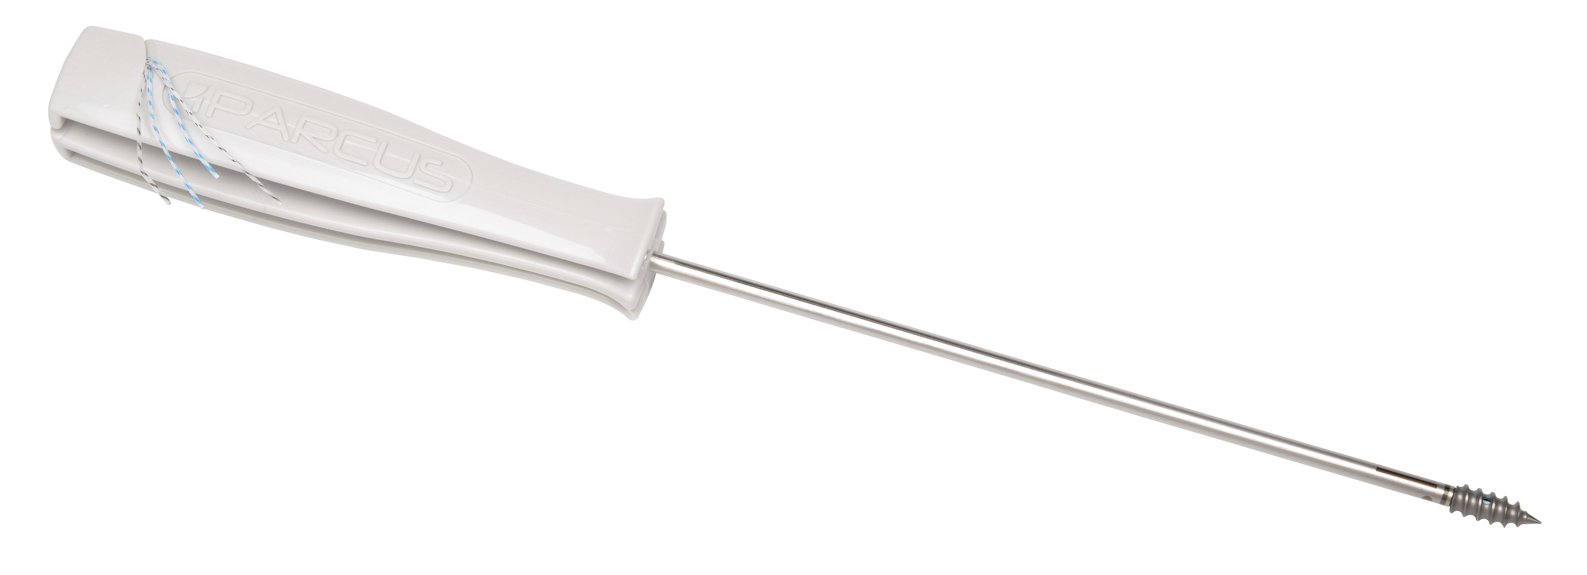
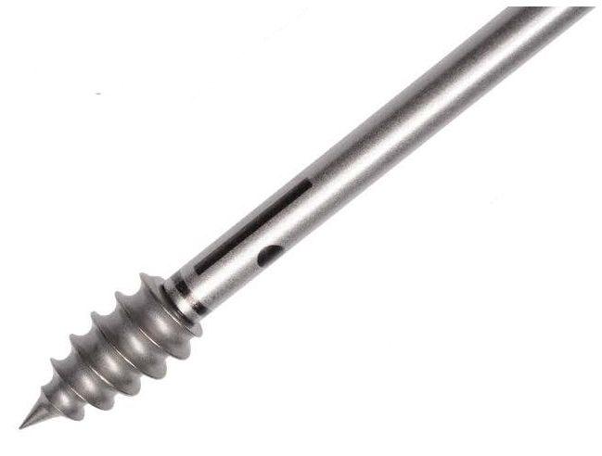
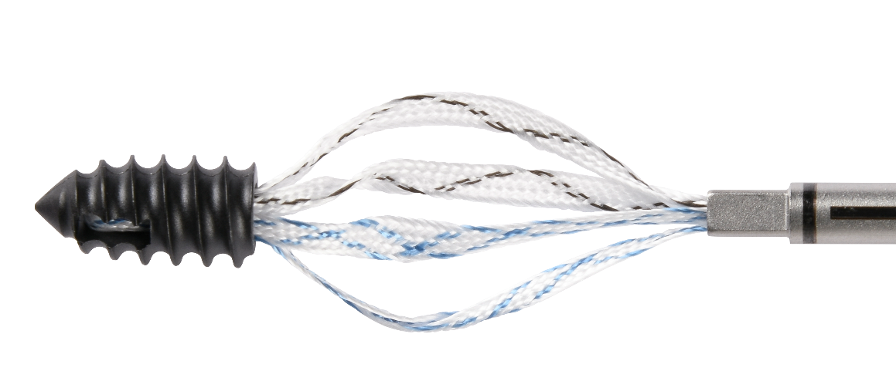
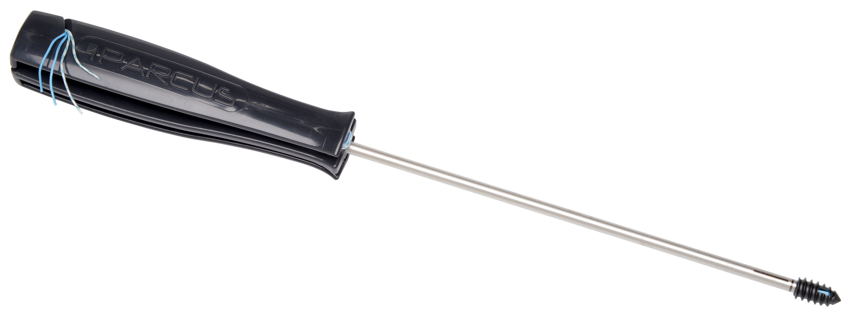
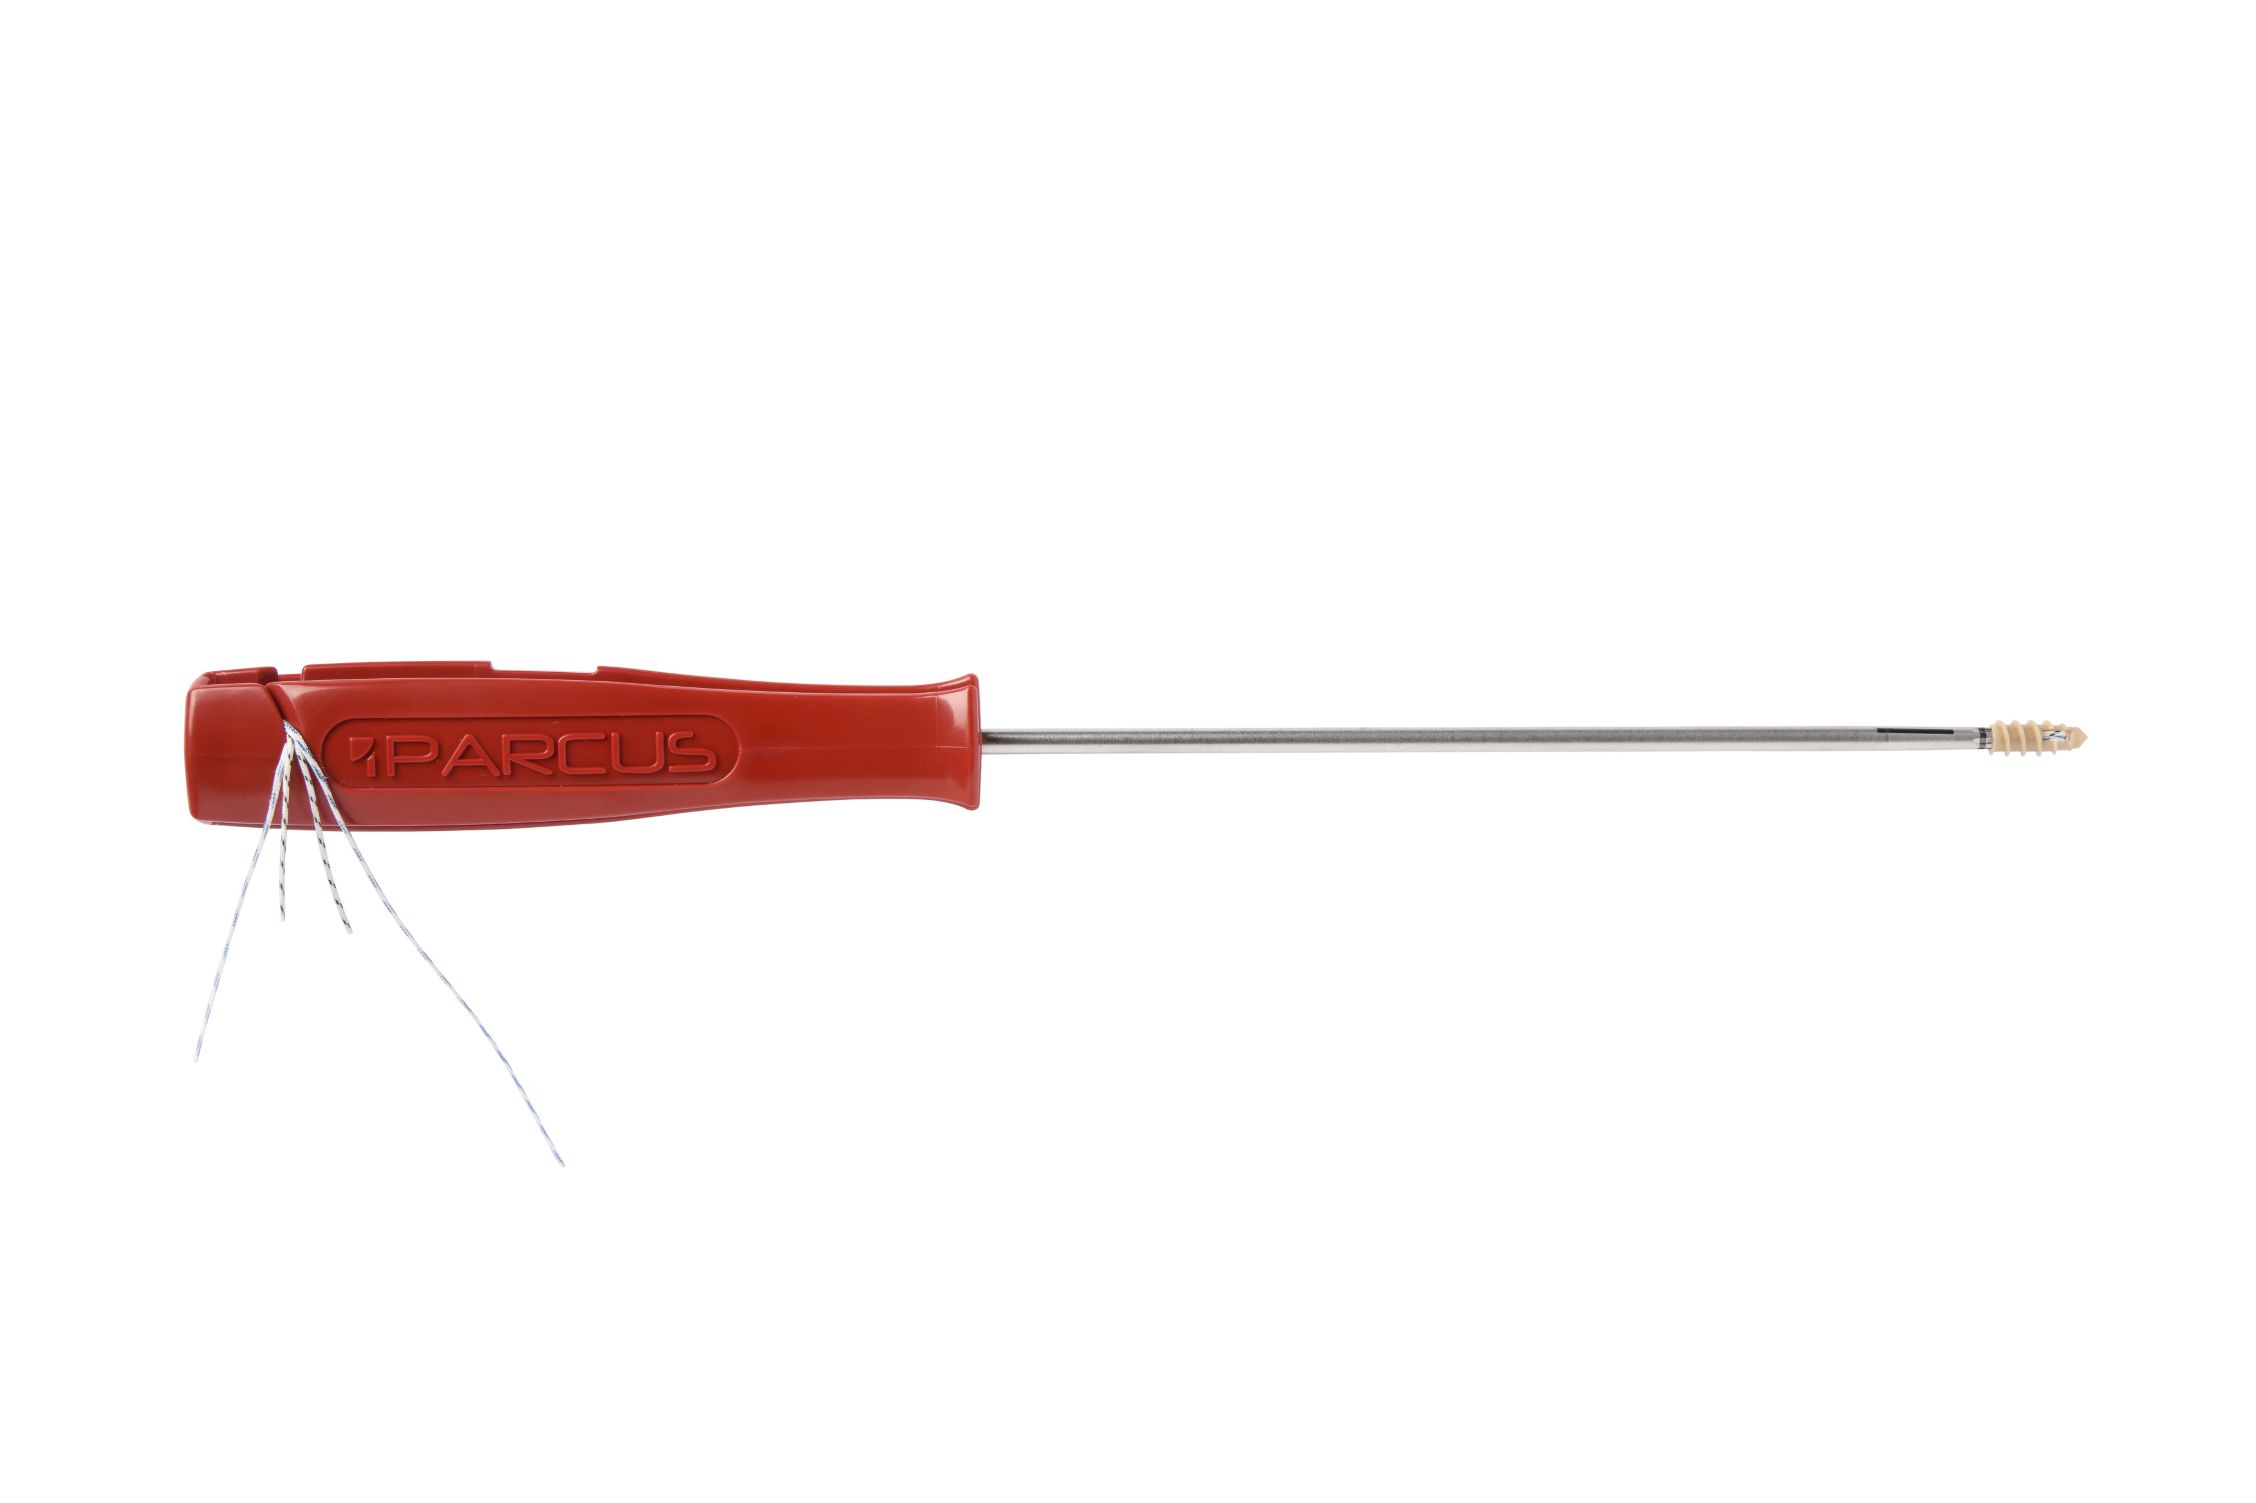
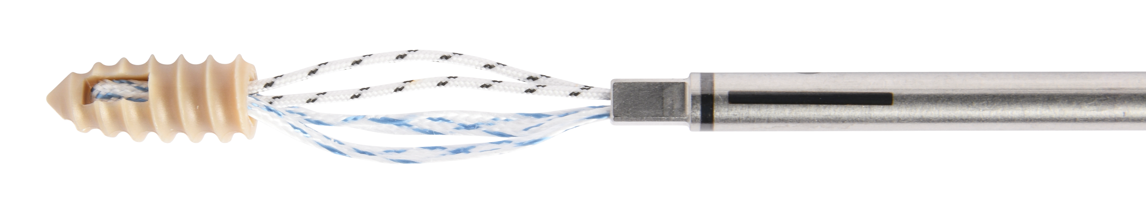
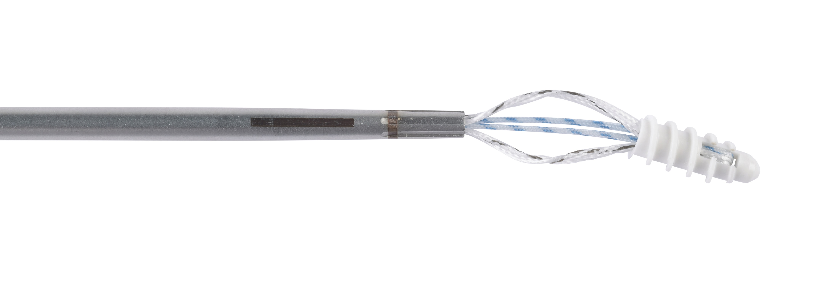
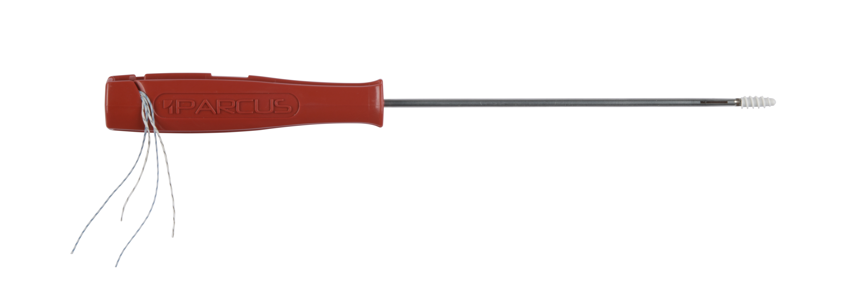
VÍT CHỈ NEO - Knotted anchors
V-LoX Titanium
V-LoX PEEK CF
Twist PEEK
Twist Biocomposite

Slide 6
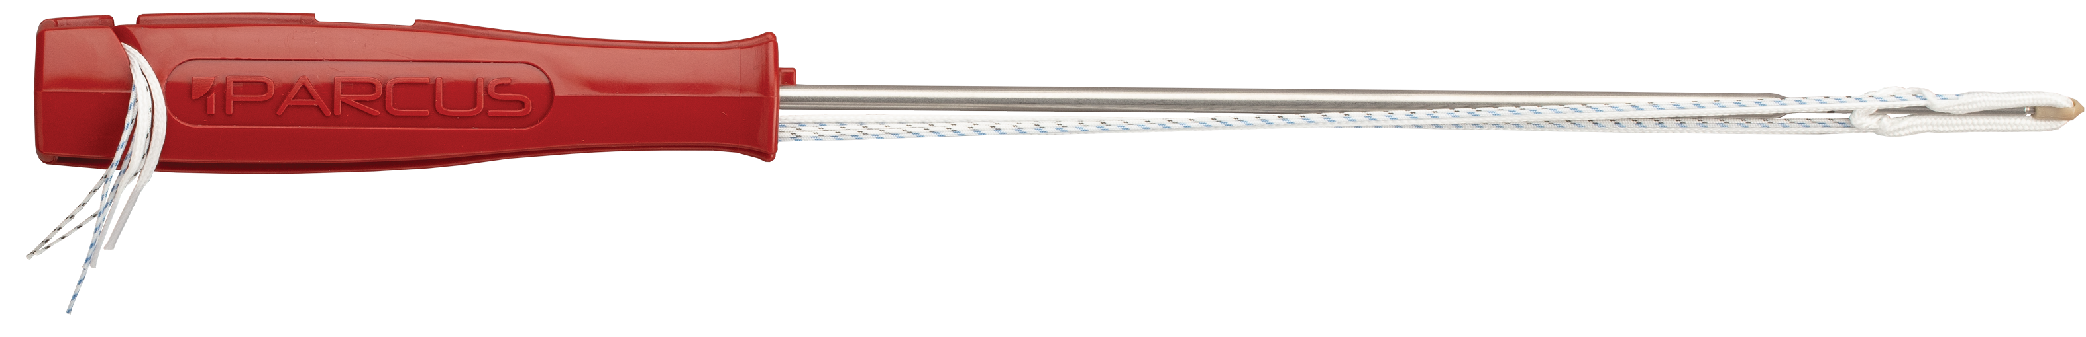
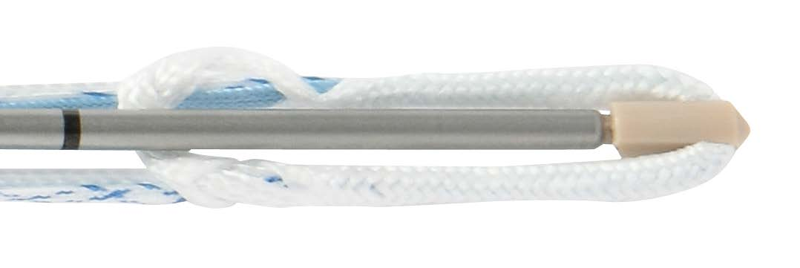
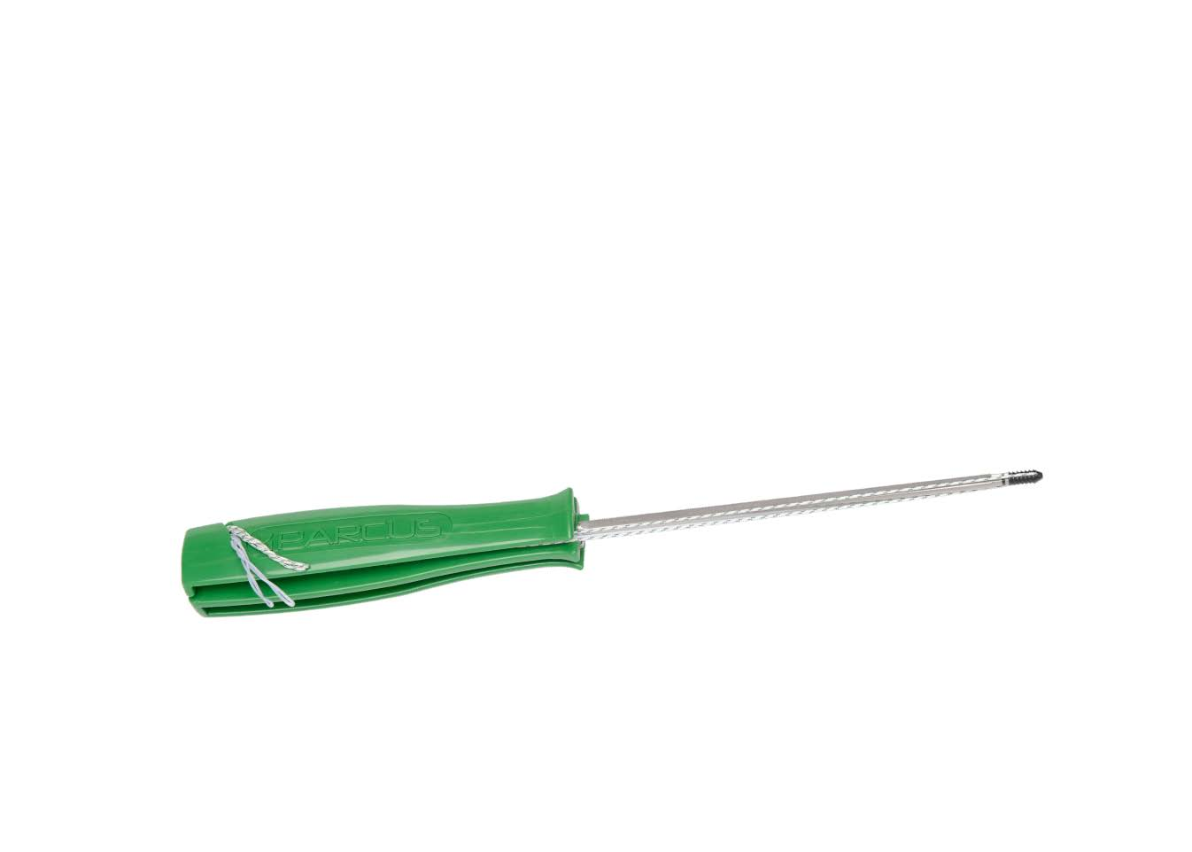
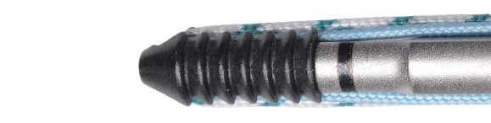
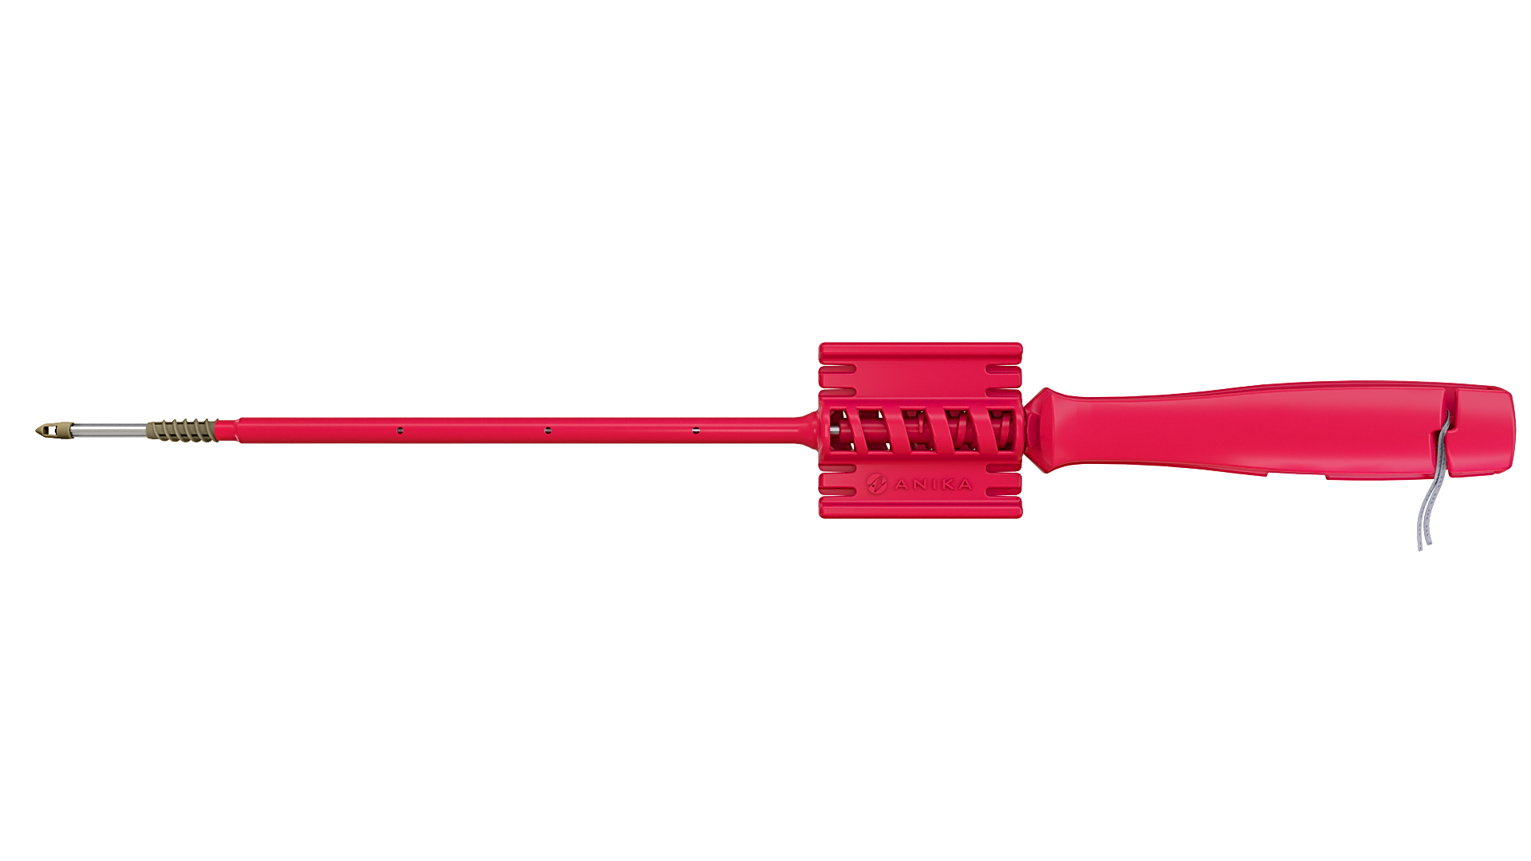
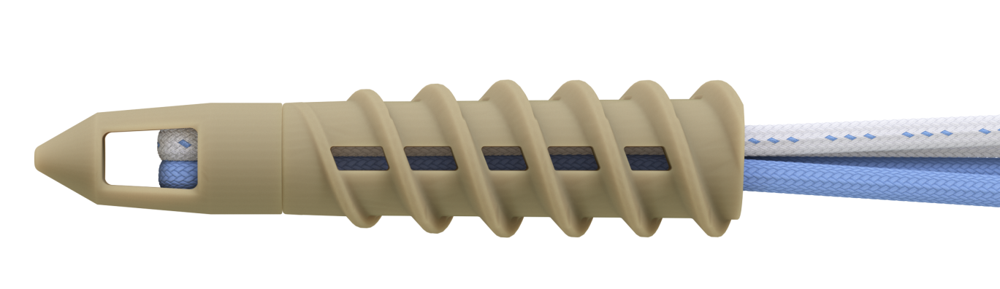
VÍT CHỈ NEO - Knotted anchors
Draw Tight
PEEK CF Push-In
X-Twist
X-Twist

Slide 7
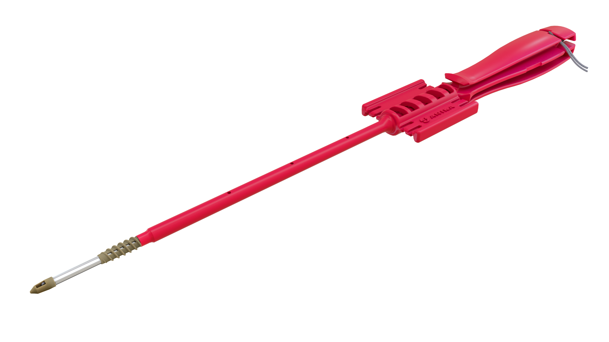
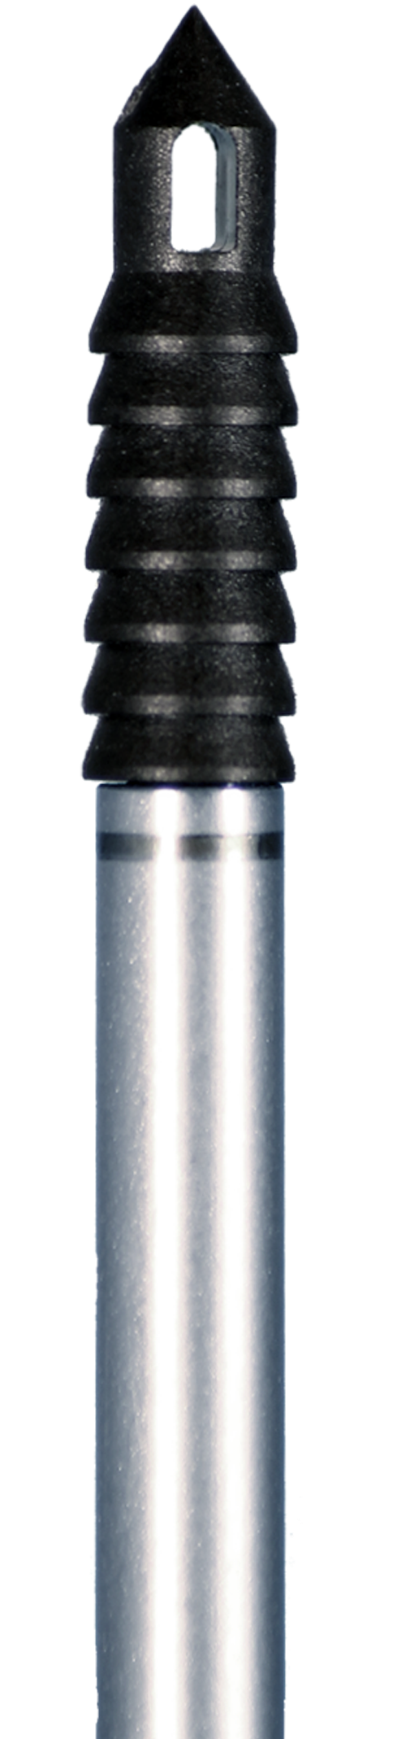
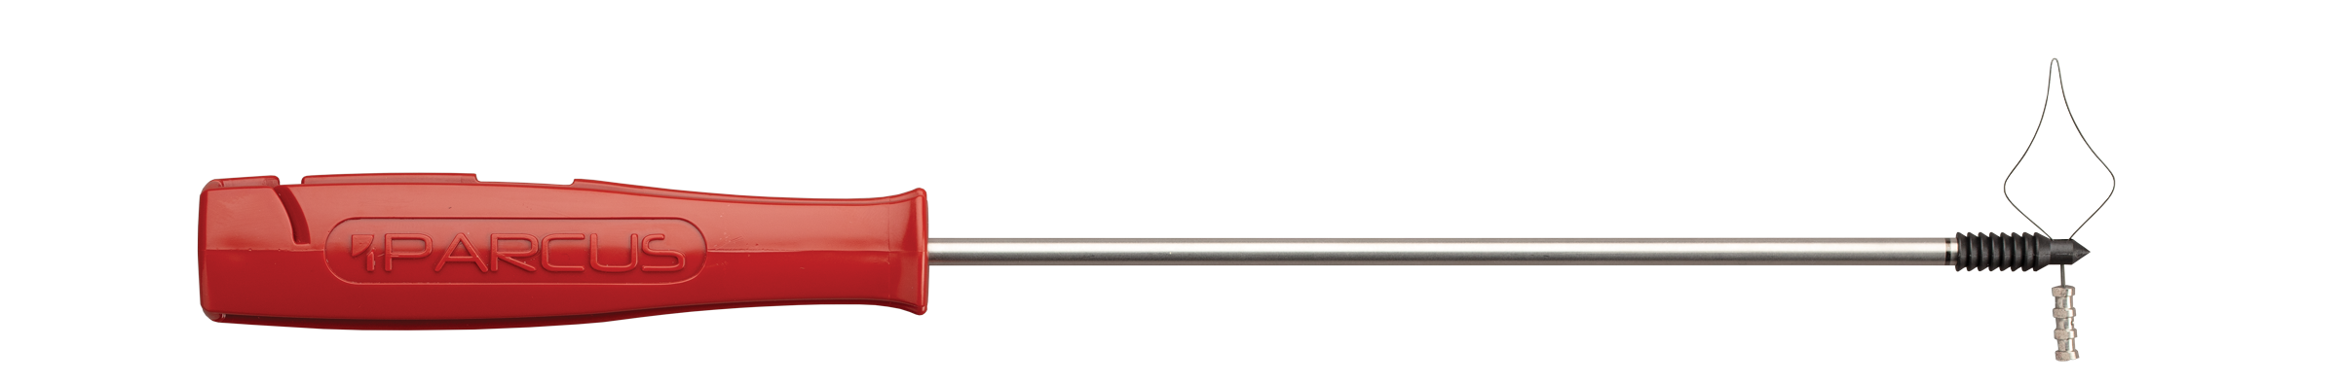
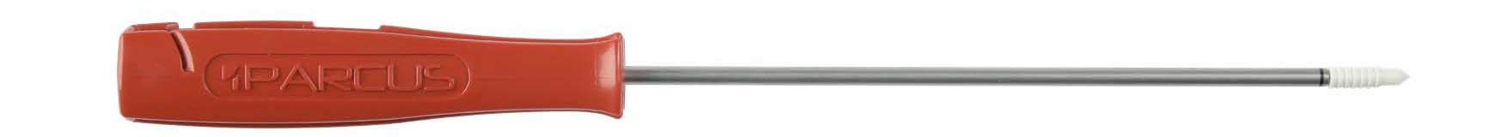
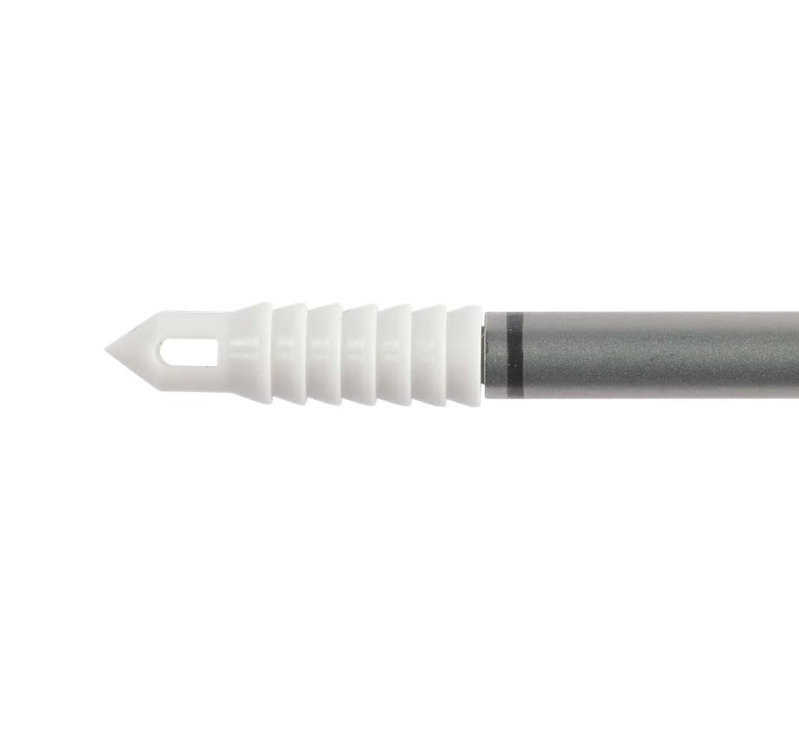
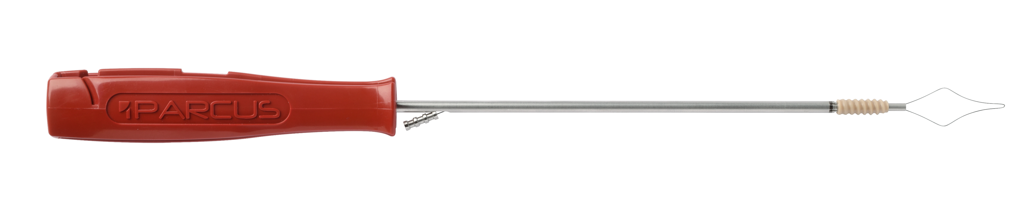
VÍT NEO - Knotless anchors
X-Twist
Knotless PEEK CF
Knotless AP
Twist Knotless

Slide 8
V-lox Titanium VÍT CHỈ NEO - Knotted anchors
Sizes: 4.5, 5.0, 5.5, 6.5mm Vật liệu - Material: Titanium
Mỏ neo ngựa - Workhorse anchor
Sử dụng dễ dàng và tin cậy - Quick, easy and reliable
Độ bền và ổn định cao - High strength and stability
Ren toàn bộ thân giảm thiểu nguy cơ bị kéo ra - Fully threaded reduces risk of pull-out
Tiết kiệm bước ren giảm thiểu khoan nhiều xương - Step saving by minimising bone preparation
Thiết kế có hoặc không có kim - With or without needles
Được lắp sắp với chỉ số 2 - Pre-loaded with #2 sutures
Có thể 2 chỉ hoặc 3 chỉ - Double or triple loaded

Slide 9
V-lox PEEK CF VÍT CHỈ NEO - knotted anchors
Sizes: 5.5, 6.5mm Vật liệu - Material: PEEK CF
Sản phẩm đầu tiên thuộc nhóm vít chỉ neo được làm từ vật liệu sợi các bon và PEEK OPTIMA - First family of suture anchors manufactured from carbon fiber reinforced PEEK OPTIMA
Chủ yếu được dùng cho khớp lớn - Primarily used in larger joints
Ren toàn bộ thân giảm thiểu nguy cơ bị kéo ra - Fully threaded reduces risk of pull-out
Thiết kế có hoặc không có kim - With or without needles
Được lắp sẵn với chỉ số 2 hoặc chỉ dẹt 1,6mm - Pre-loaded with #2 sutures or 1.6mm suture tapes
Có thể 2 chỉ hoặc 3 chỉ - Double or triple loaded
An toàn, tương thích sinh học, cản quang - Safe - Biocompatible, radiolucent, MR safe, inert

Slide 10
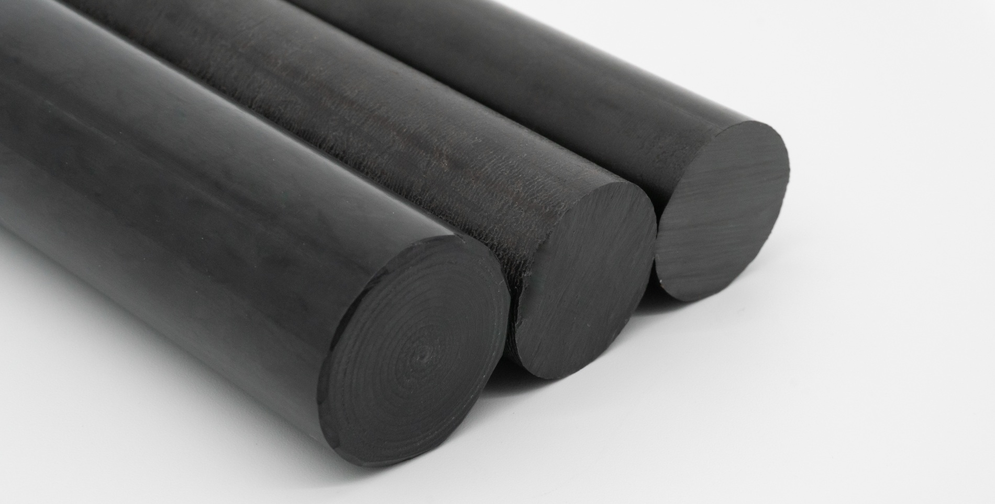
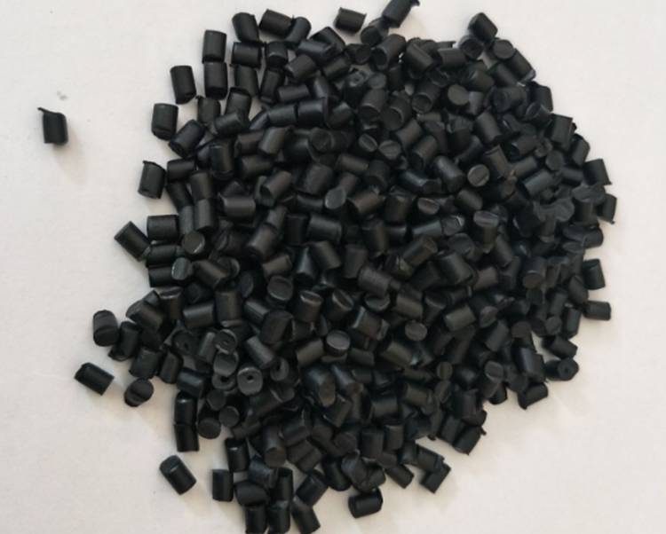
Vật liệu? PEEK CF - what is it?
Vật liệu Polyetheretherketone được gia cố bằng sợ các bon - Carbon fiber-reinforced Polyetheretherketone (PEEK)
  Sợi carbon ngắn được phân tán trong vật liệu PEEK tự nhiên - Short carbon fibers dispersed within natural PEEK
  Có màu đen bóng - Glossy black finish
  Tăng độ cứng và chắc chắn hơn vật liệu PEEK tự nhiên - Increased stiffness and strength over natural PEEK
  Có sẵn với các tỉ lệ sợi các bon khác nhau - Available in varying percentages of carbon fiber
    Parcus độc quyền với tỉ lệ 30% sợi các bon - Parcus exclusively uses 30% carbon fiber PEEK
Dùng trong y tế - Used in Medical Devices
  Không xê dịch, bất động - Inert
  Khả năng chống mài mòn cao - Excellent wear resistance
  Tương thích sinh học - Biocompatible
  Cản quang và an toàn - Radiolucent and MR safe
  Chứng chỉ FDA/CE
  Được sử dụng hơn 20+ years

Slide 11
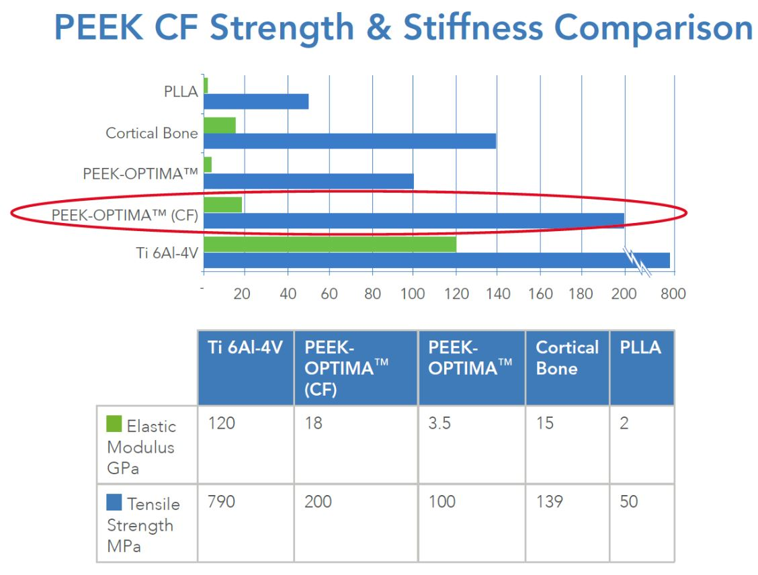
ĐẶC TÍNH VẬT LIỆU - PEEK CF - MATERIAL PROPERTIES
Elastic Modulus
How much pressure can be applied before the material permanently deforms
Example: paperclip bends and returns to its normal shape up until its elastic modulus is exceeded
Tensile Strength
How much pressure the material can take before it breaks
Example: pencil snaps in half once the tensile strength is exceeded

Slide 12
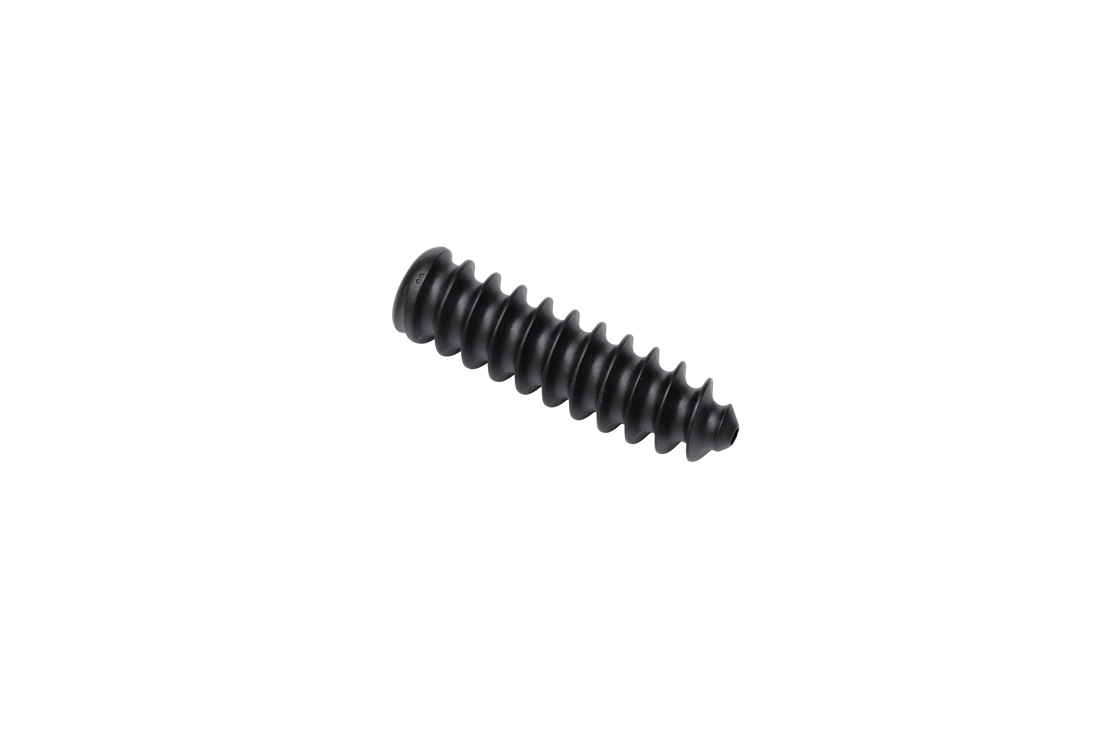
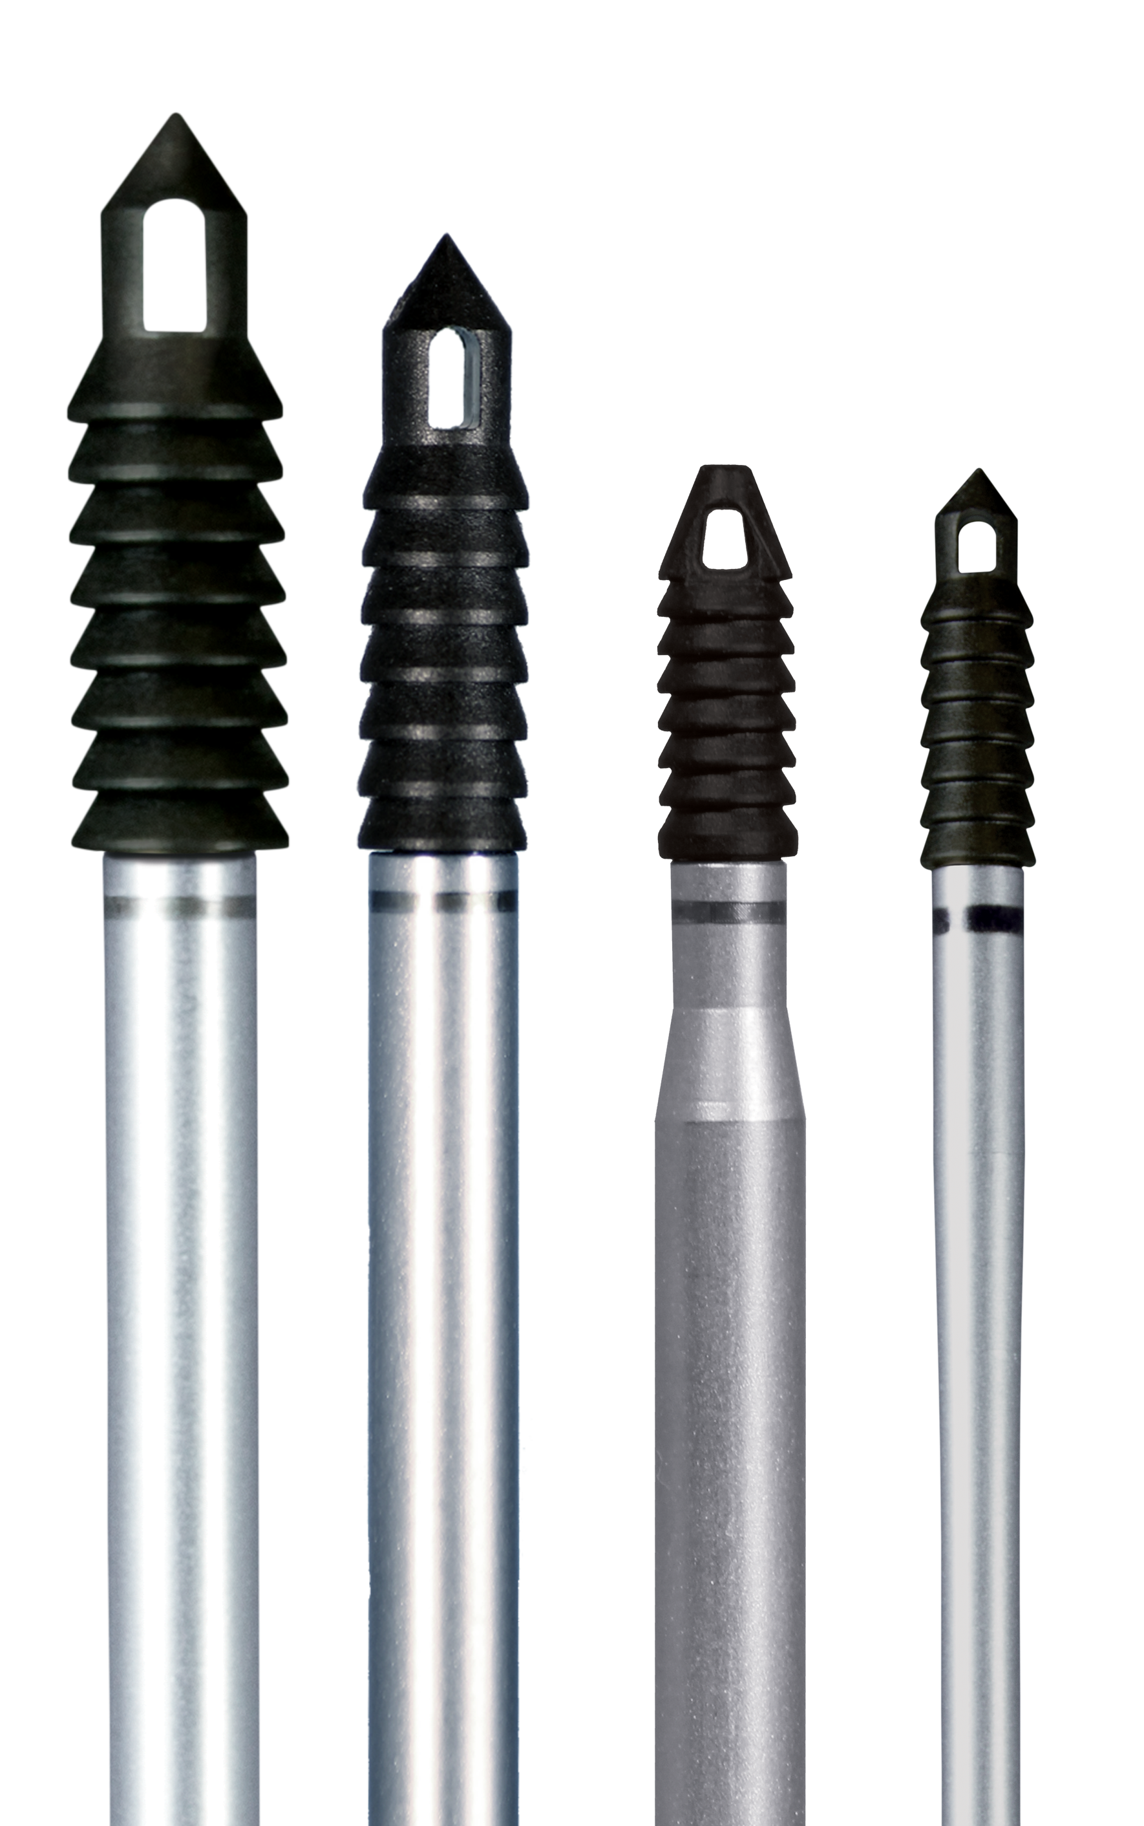
Peek cf - advantages
2x stronger than PEEK
Excellent performance for interference screws
Capable of insertion into very hard bone
Self-punching in some instances
Closer mechanical properties to cortical bones than other materials
Bone is neither weakened nor stressed after implantation
Bone-life stiffness may reduce the occurrence of stress shielding whilst enhancing bone healing
Safe
100% inert
Easily removable in revision surgeries
Proven biocompatibility to ensure safe long-term implantation
Radiolucent on X-Rays and CT Scans, and MR safe

Slide 13
Twist knotted anchors
Sizes: 4.5, 5.5, 6.5mm Material: PEEK or Biocomposite
Widest variety of configurations
  PEEK or Biocomposite material
  With or without needles
  Double or triple loaded
  #2 suture, 1.6mm suture tape, 2mm suture tape
Fully threaded design provides optimal cortical fixation which reduces the risk of pull out
Great option for streamlined repair

Slide 14
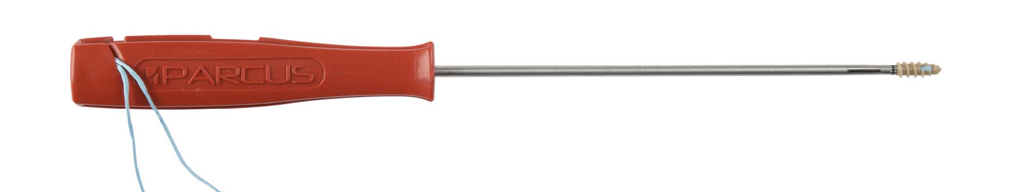
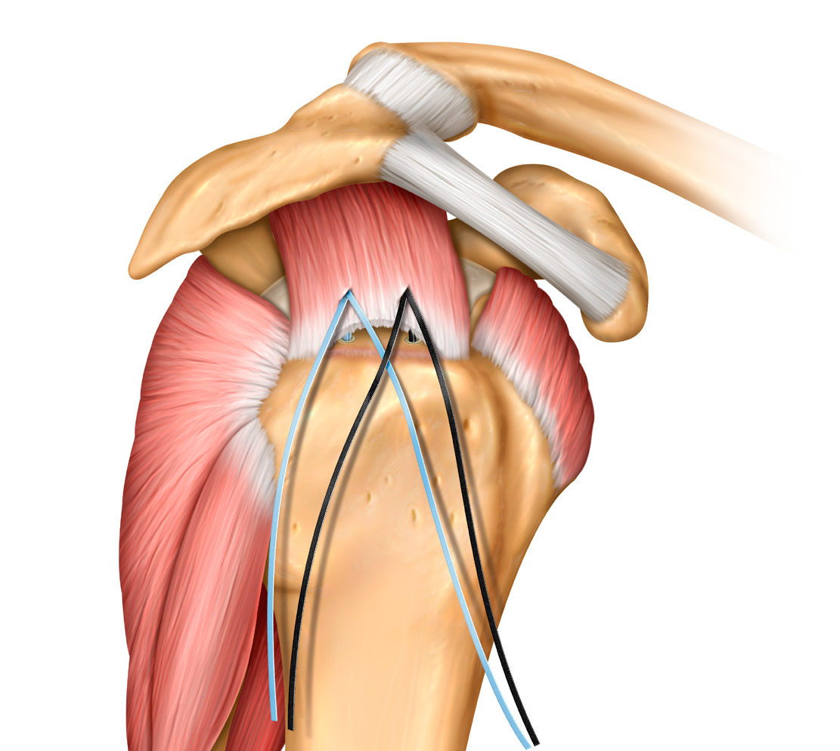
Twist SST knotted anchors
Sizes: 4.5, 5.5, 6.5mm Material: PEEK or Biocomposite
Pre-loaded with a non-sliding, locked in, 2mm suture tape
Allows for true knotless repair
Single handed insertion vs. competitors options
Tape handles better than competitors’
Slack taken up by the lateral row = easier & consistent tensioning
Eliminates knot tying, and potential knot irritation

Slide 15
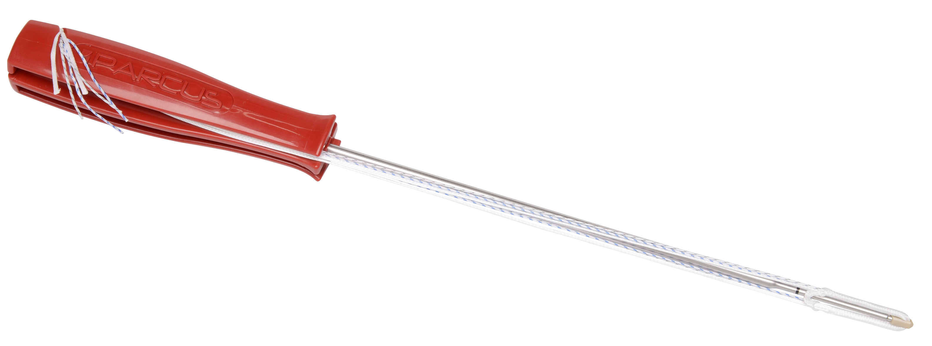
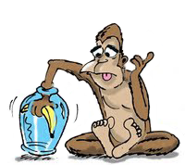
Draw tight knotted anchors
Sizes: 1.8, 3.2mm Material: UHMWPE + PEEK
Soft vs. hard anchors
Safe
Bone sparing
Revision friendly
Allow for multiple points of fixation
Work on expansion after insertion

Slide 16
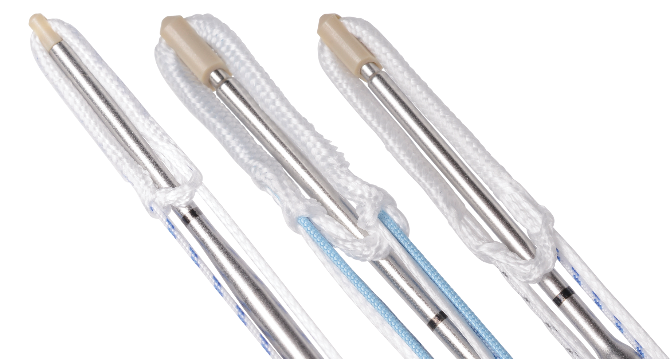
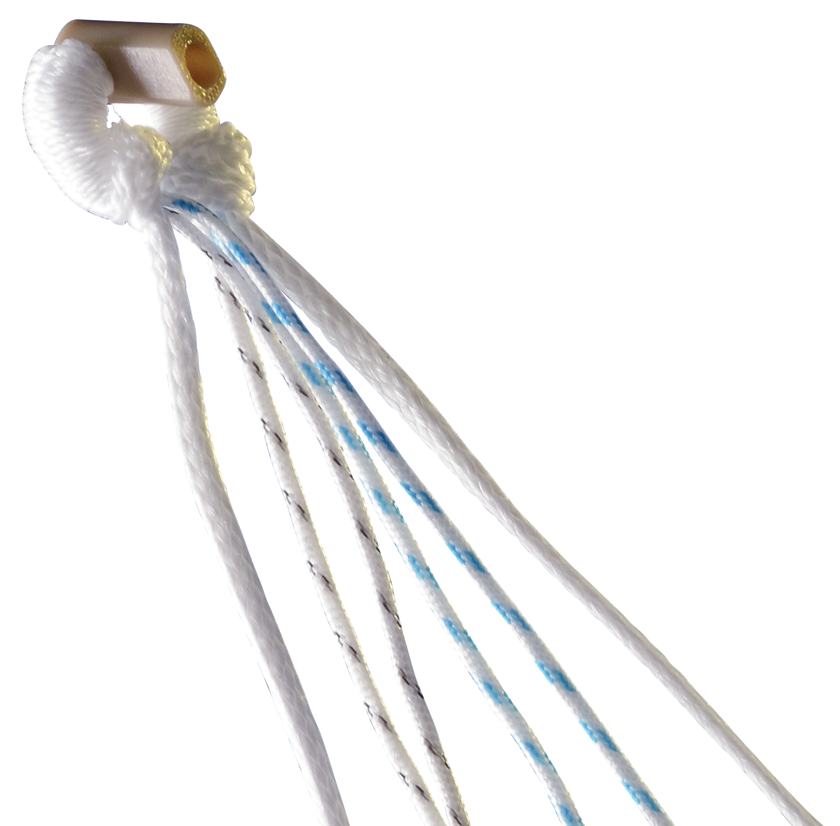
Draw tight knotted anchors
Sizes: 1.8, 3.2mm Material: UHMWPE + PEEK
Deployable Suture Based Anchor
Two sizes
Unique Deployment Suture that provides tactile feedback for positive fixation
PEEK Power tip for improved insertion and solid core for stronger fixation
Preloaded with Suture or Suture Tape
Distal extremity option with needles

Slide 17
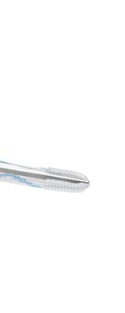
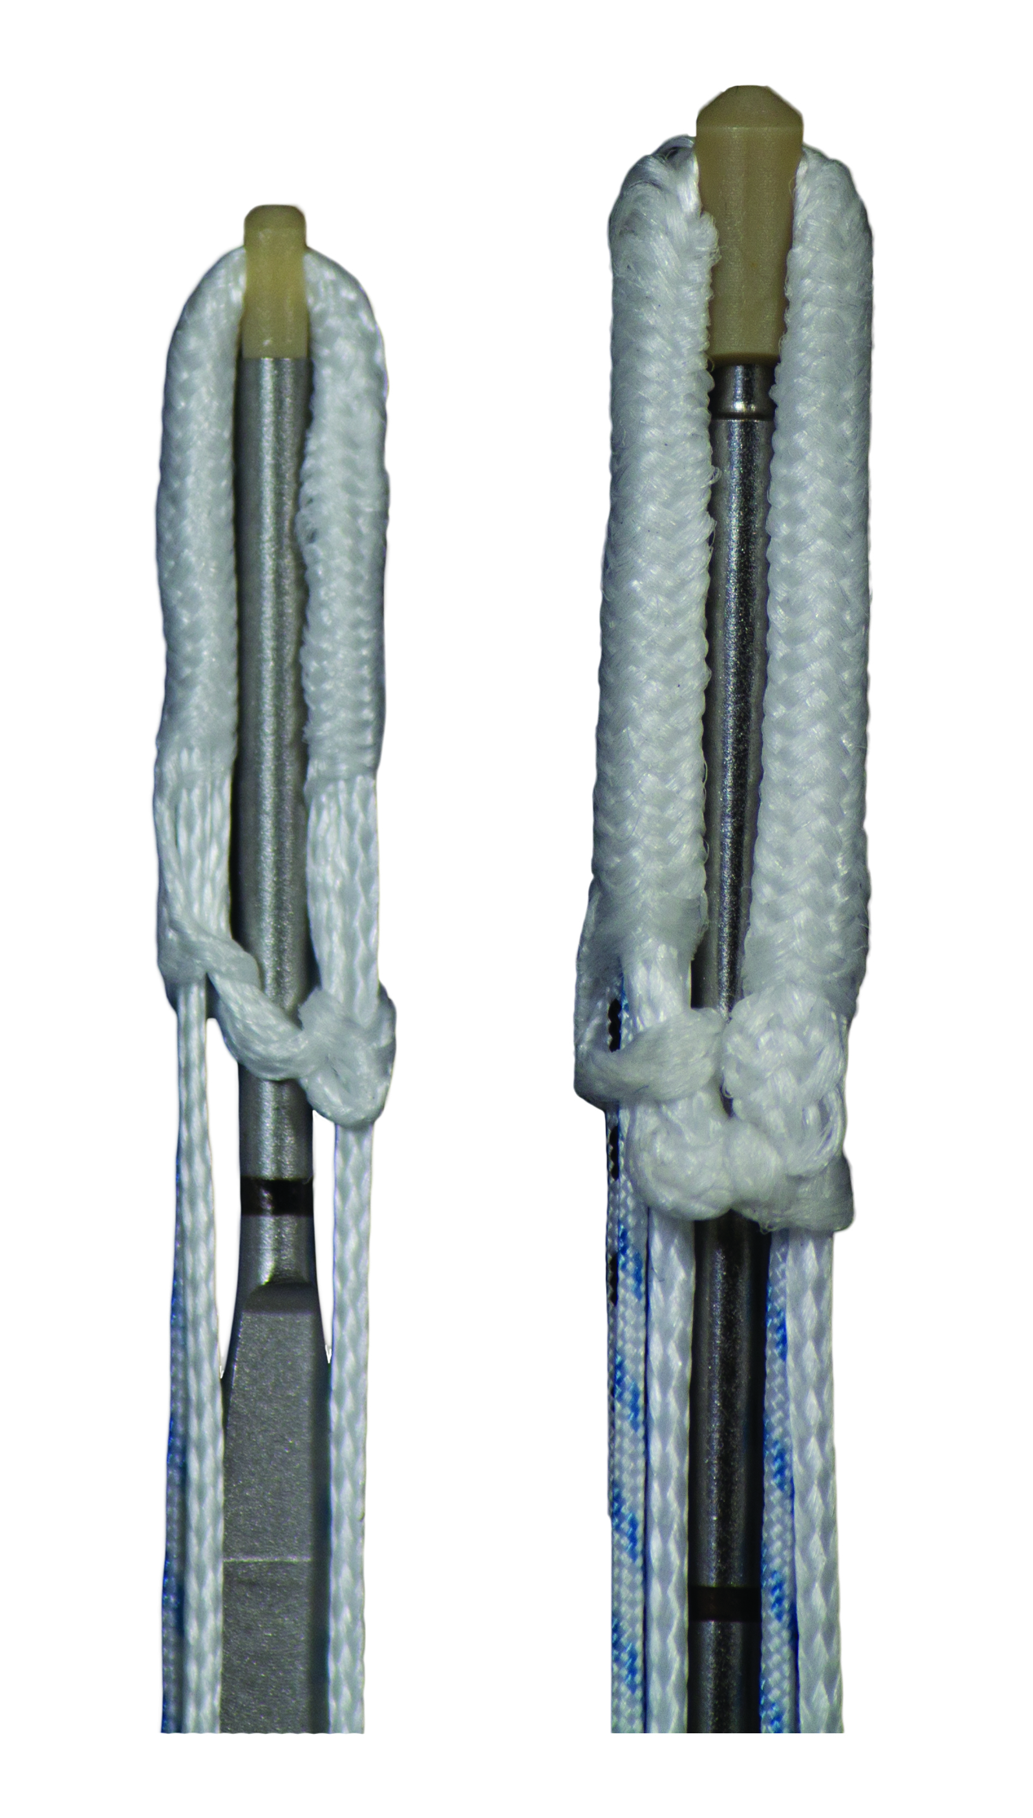
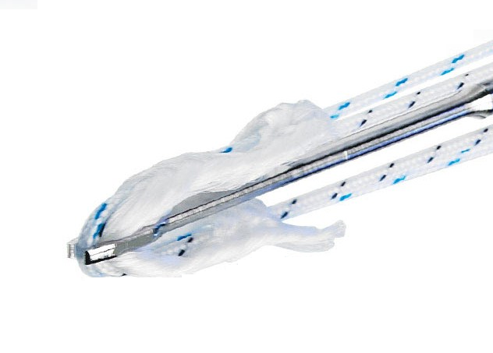
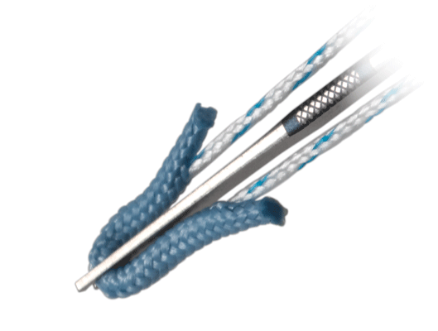
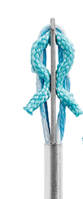
Draw tight knotted anchors
Sizes: 1.8, 3.2mm Material: UHMWPE + PEEK
PEEK Power Tip
Improved insertion vs. nitinol fork of direct competition
Provides solid core translating to stronger fixation

Slide 18
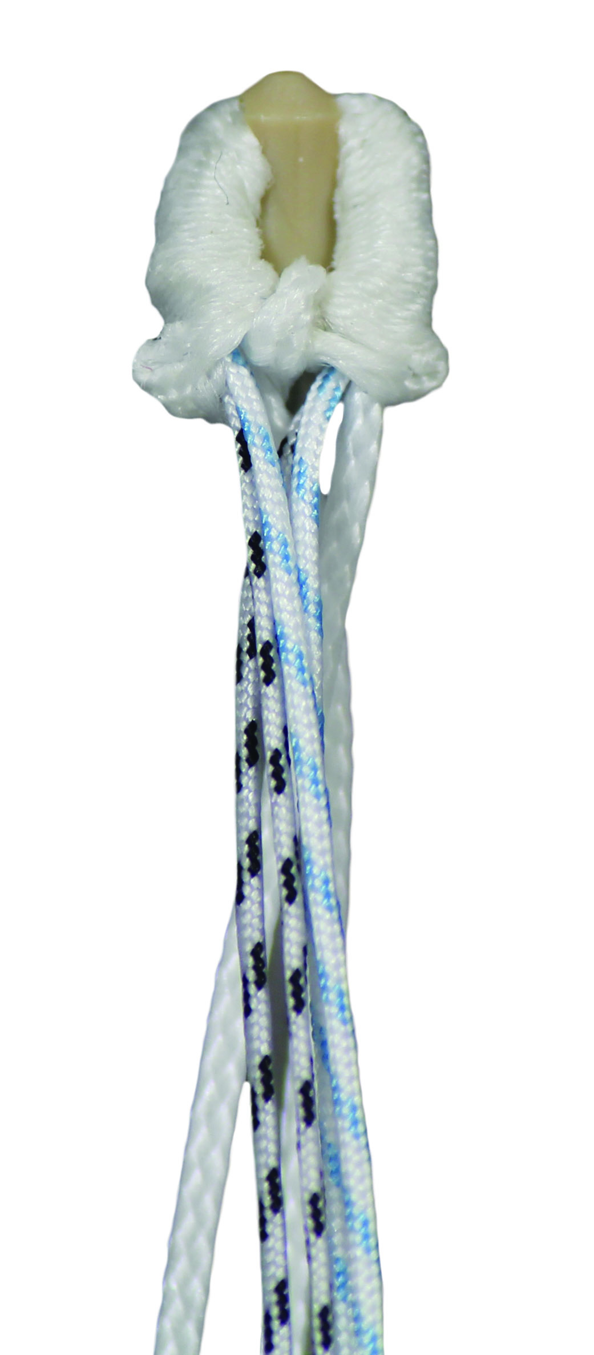
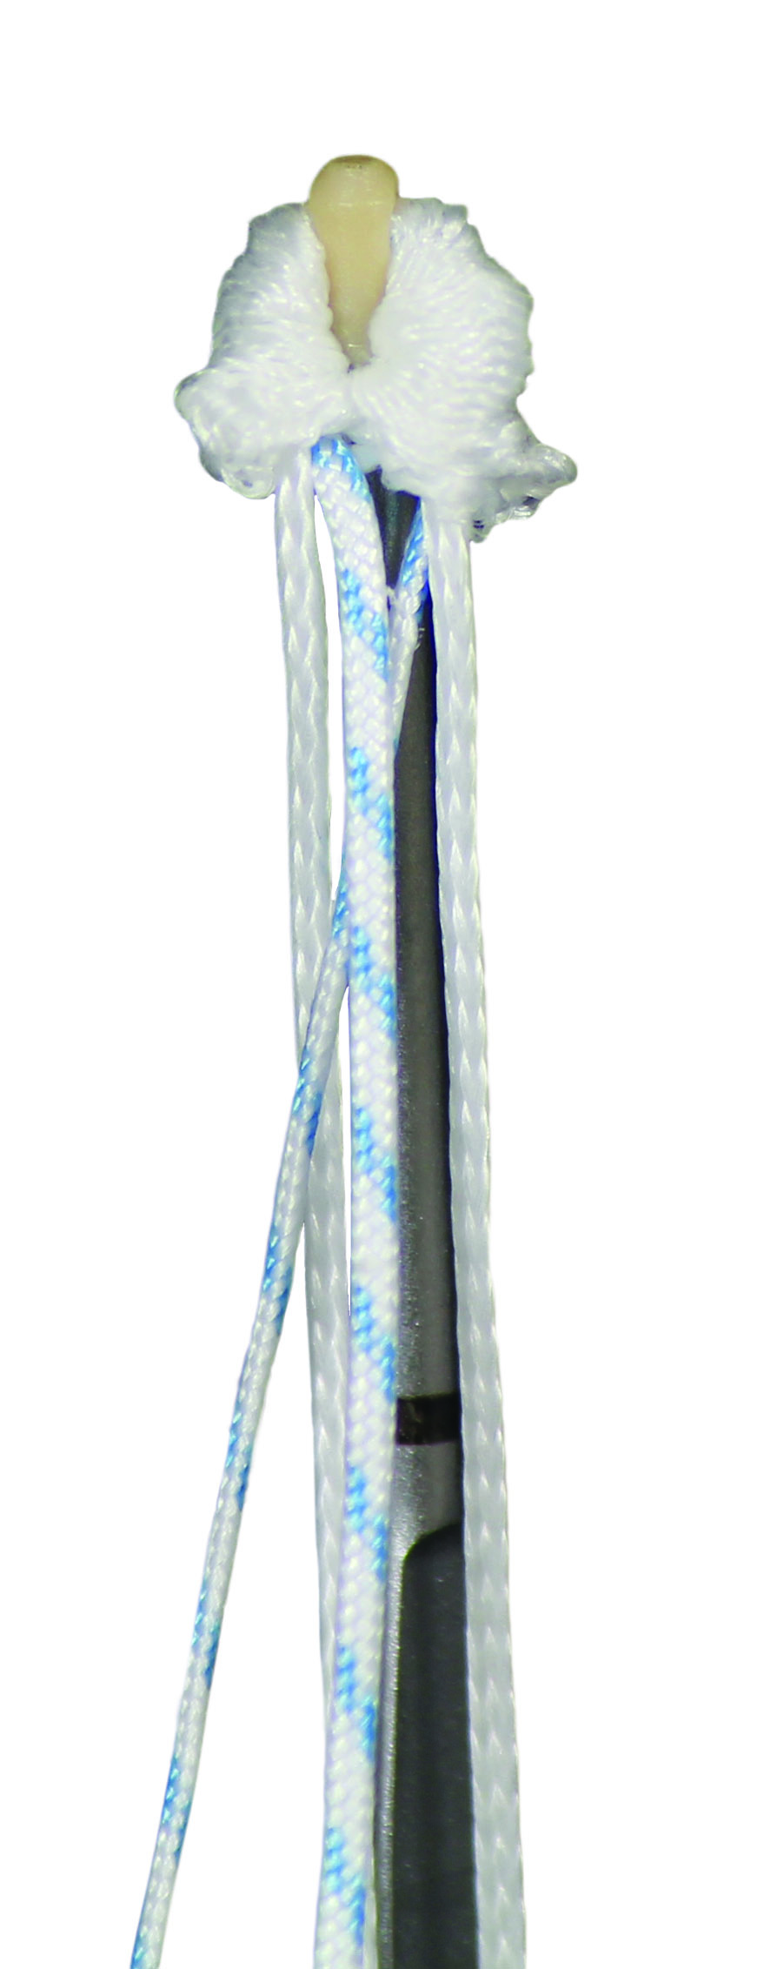
Draw tight knotted anchors
Sizes: 1.8, 3.2mm Material: UHMWPE + PEEK
White deployment sutures
Unique among all-suture anchors
Provides tactile feedback for positive fixation
Ability to utilize static deployment sutures
One of the shortest drill depth of any suture based labral anchor (19mm)
Size of the suture ball after deployment?
1.8mm Draw Tight ~ 3.5mm, 3.2mm Draw Tight ~ 5.5mm

Slide 19
Peek cf push-in Knotted anchors
Size: 3.5mm Material: PEEK CF
Simple push in anchor with high pull-out strength
With or without needles
Loaded with #2 suture or 1.6mm suture tape
PEEK CF material
Strength to find glenoid hole
Modulus of elasticity matches bone reducing stress on glenoid

Slide 20
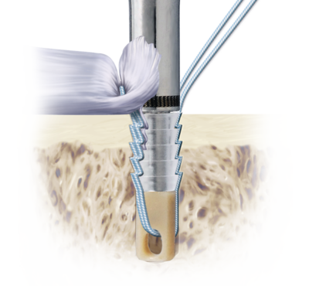
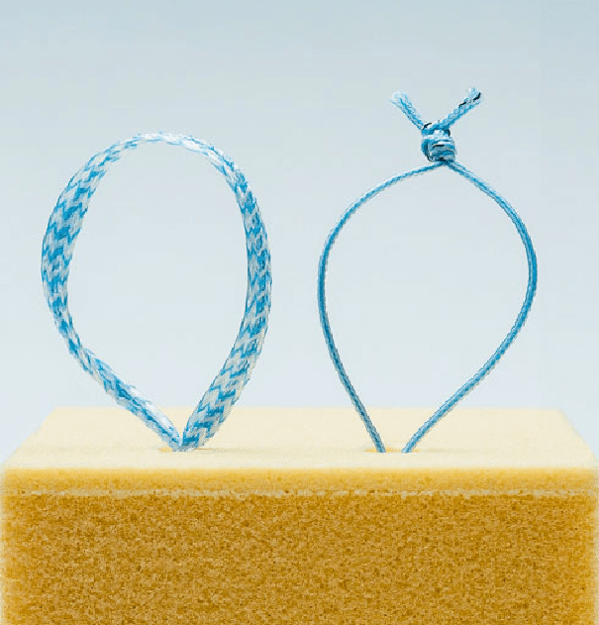
Knotless anchors
Newer technology compared to knotted (pre-loaded) anchors
Not preloaded with suture
Can be used in:
  All joints
Can be made from:
  Titanium
  PEEK
  PEEK CF
  Biocomposite (absorbable)
  All-Suture (Soft)
Can be loaded with
  Suture
  Tape
Instability sizes = 2.8mm – 3.5mm
Rotator Cuff sizes = 3.5mm – 6.25mm

Slide 21
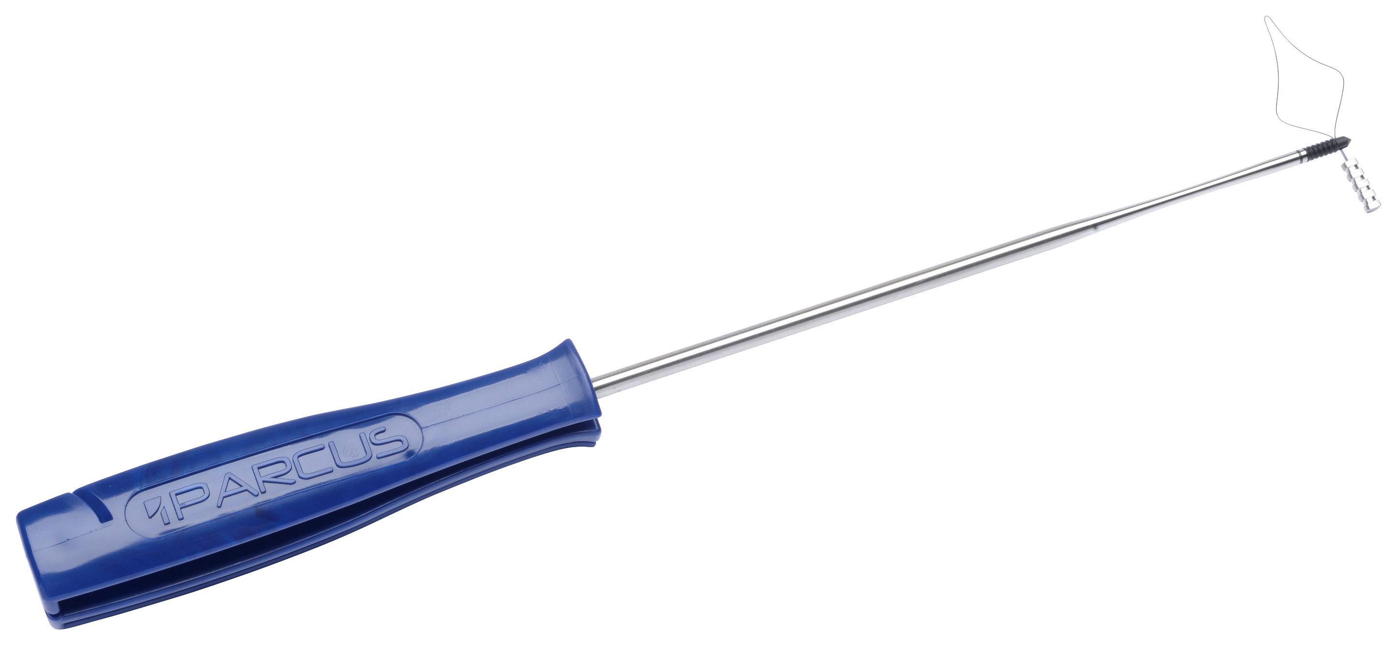
Knotless PEEK CF knotless anchors
Sizes: 2.8, 3.5, 4.5, 5.5mm Material: PEEK CF
Strong solid piece design
Self punching for most rotator cuff repairs
PEEK CF material
Large eyelets to accommodate multiple suture configurations
Simple and reproducible technique for instability and rotator cuff repair
Modulus of elasticity closely matching cortical bone
Eco-friendly & cost-effective re-usable handle option

Slide 22
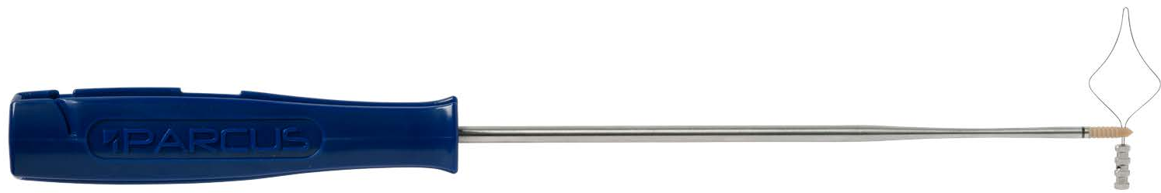
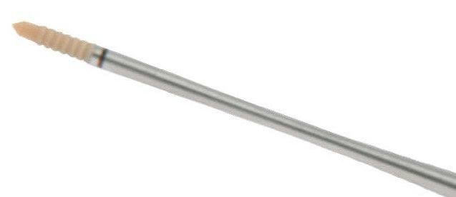
Knotless PEEK knotless anchors
Size: 2.8mm Material: PEEK
Strong solid piece design
PEEK material
Can accommodate suture or tape
Simple and reproducible technique for instability
Non-absorbable, radiolucent, MR safe
Available in standard and hip length

Slide 23
Knotless AP knotless anchors
Sizes: 2.8, 4.5, 5.5mm Material: Advanced Polymer
Advanced Polymer
  70% PLGA – Biocompatible, absorbable and comprised of naturally occurring compounds
  30% ß –TCP – Osteoconductive and facilitates adhesion of osteoblasts, and supports bone integration and ingrowth
Resorbable, radiolucent, MR safe
Strong solid piece design
Large eyelets to accommodate multiple suture configurations
Simple and reproducible technique for instability and rotator cuff repair

Slide 24
Twist knotless knotless anchors
Sizes: 4.75, 5.5, 6.25mm Material: PEEK
Eliminates possibility of over tensioning repair
  Sutures run along anchor and up center of anchor, instead of alongside
Strong solid piece design
Inserter nose to help with axial alignment
Single handed insertion
Accommodates multiple sutures/tapes
Simple and reproducible technique for rotator cuff repair
Short handled option for distal extremities

Slide 25
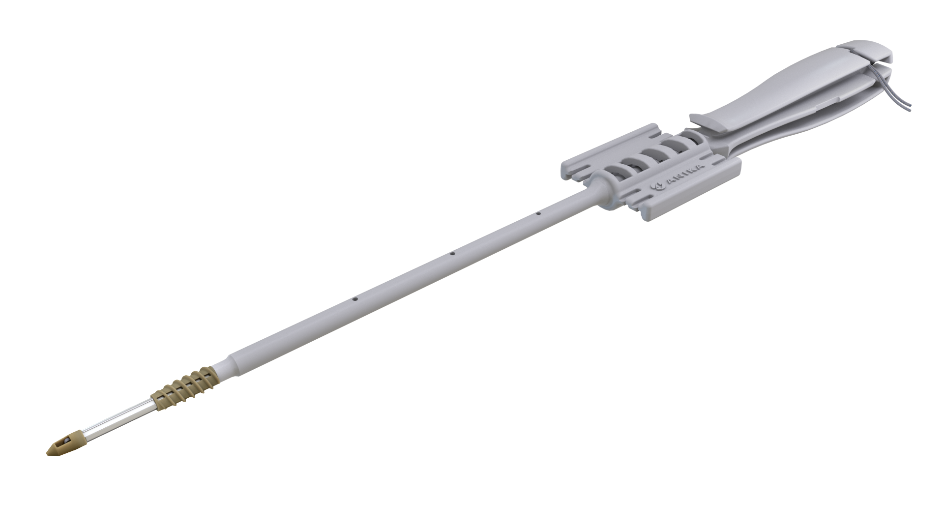
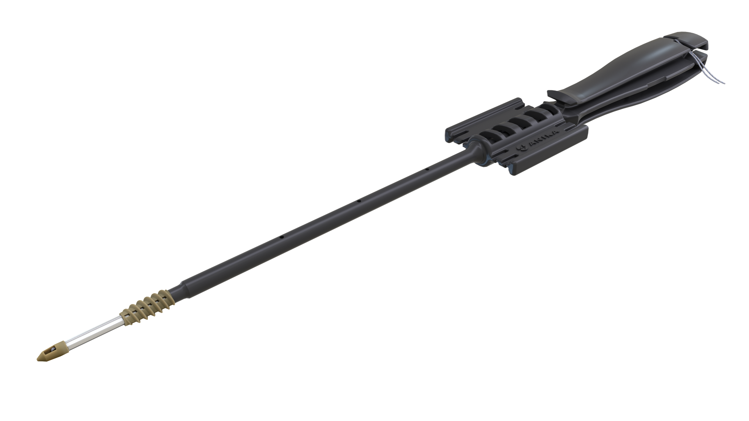
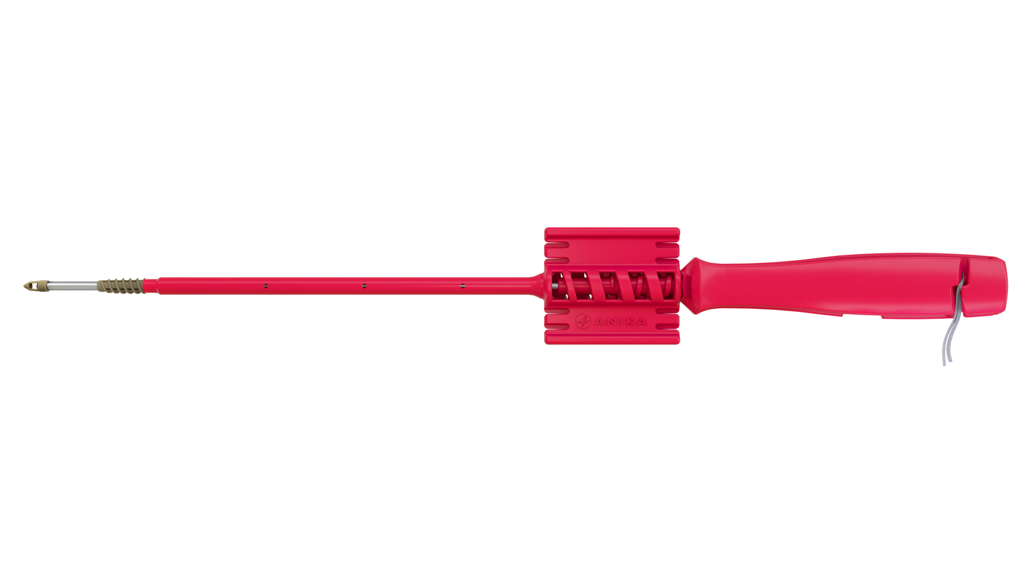
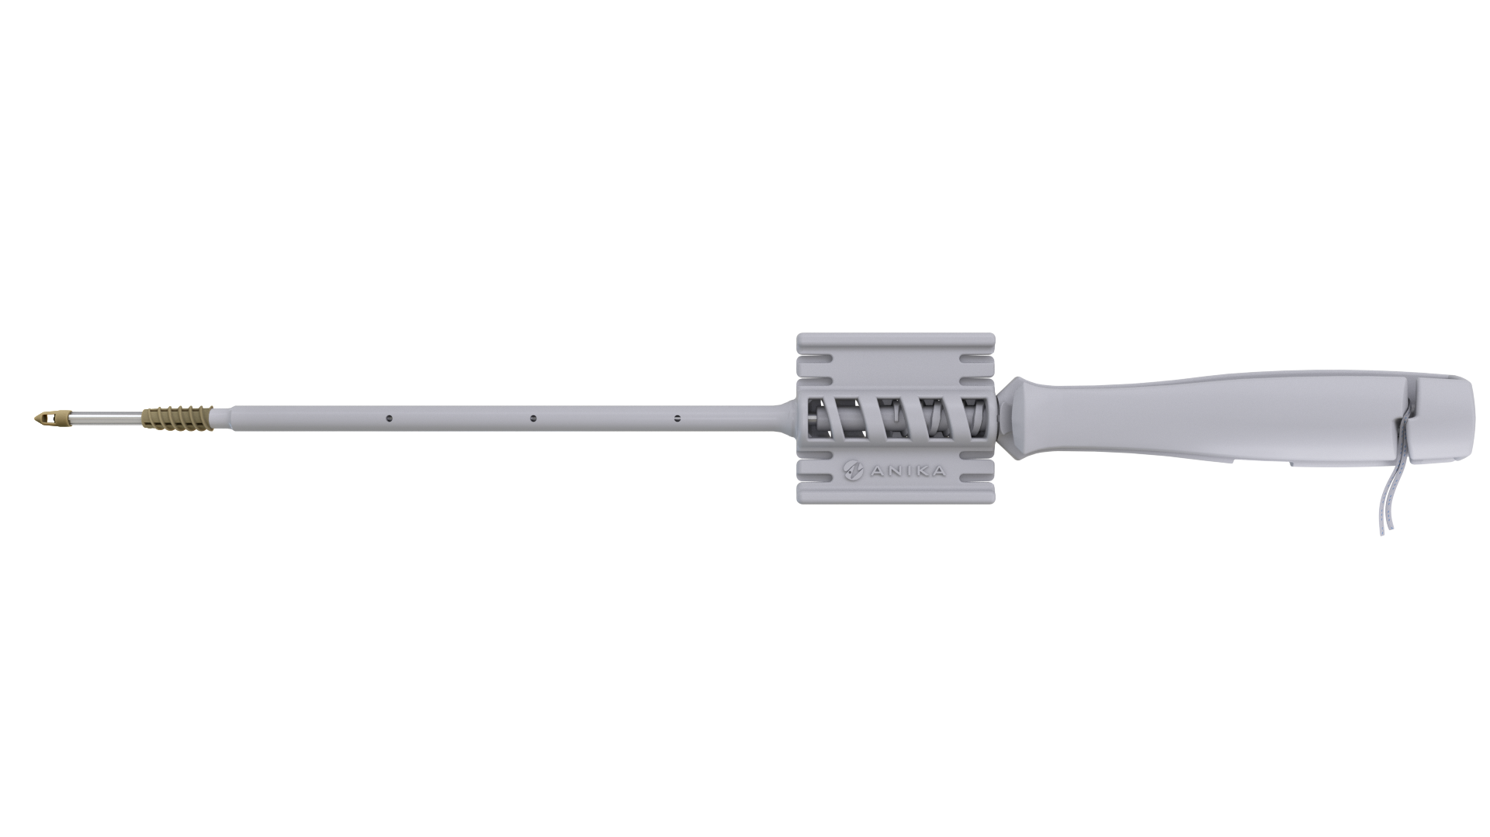
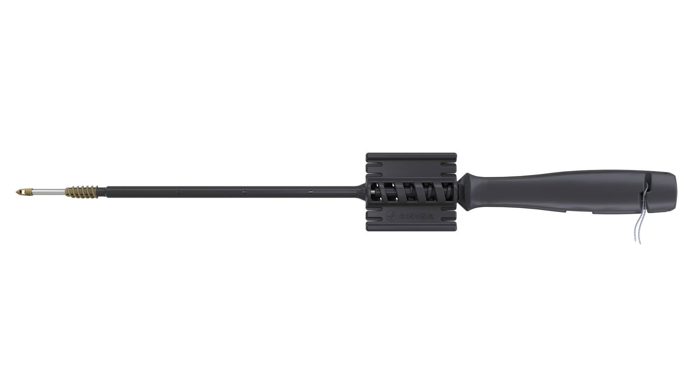
X-Twist knotless anchors
Sizes: 4.75, 5.5, 6.25mm Material: PEEK
Versatile
Strong
Supports healing
Quick & easy to use
4.75mm
5.5mm
6.25mm

Slide 26


X-Twist knotless anchors
Sizes: 4.75, 5.5, 6.25mm Material: PEEK
True Surgical Freedom
Intra-operative flexibility
One product that allows for multiple techniques
Knotless anchor that can be used like a knotted anchor
  Load sutures through distal eyelet
Knotted anchor
  Preloaded with sliding suture or tape/s
Sliding

Slide 27

X-Twist knotless anchors
Sizes: 4.75, 5.5, 6.25mm Material: PEEK
Large Distal Eyelet
Accommodates four 2mm tapes & three #2 sutures
Maximise tendon to bone coverage
Versatility in repair constructs
Conical tip for easy placement

Slide 28





X-Twist knotless anchors
Sizes: 4.75, 5.5, 6.25mm Material: PEEK
Sliding
Multiple Sliding Suture Configurations
Preloaded with sliding:
  1 x #2 suture
  1 x 1.6mm suture tape
  2 x 1.6mm suture tapes

Slide 29


X-Twist knotless anchors
Sizes: 4.75, 5.5, 6.25 Material: PEEK
Double Helix Design
2 independent threads in a double helix relationship
Fast insertion
Easy-in double start thread
3 ¼ turns
Notes:
Arthrex SwiveLock = 8 turns

Slide 30








X-Twist knotless anchors
Sizes: 4.75, 5.5, 6.25mm Material: PEEK
Open Architecture Design
1.4mm vents run along four sides
Maximally cannulated
Promotes marrow element flow to repair site
Supports healing
Bony ingrowth
Notes:
Less material
Bone marrow density around the anchor

Slide 31







X-Twist knotless anchors
Sizes: 4.75, 5.5, 6.25mm Material: PEEK
Superior Anchor Driver Interface Geometry
X-Spline™
Exceptional performance
High torque capability
Reliable insertion even in hard bone
2 x Torsional efficiency vs. traditional hex design
X-Spline Driver vs Traditional Hex Design
2 x torsional efficiency
46% reduction in total anchor loading
56% reduction in radial loading

Slide 32

X-Twist knotless anchors
Sizes: 4.75, 5.5, 6.25 Material: PEEK
Smart Thread Design
Buttress thread
Easy insertion
Improved pull-out
Fully threaded
Cortical and cancellous fixation
Strength and rigidity
Tailing edge resists pull out
Leading edge facilitates insertion

Slide 33
X-Twist knotless anchors
  More Sliding Suture/Tape Options
  Easy-In Double Start Thread Design
  Double Helix Threads for fast insertion
  Stable Tip for reproducible tensioning
  Smart Buttress threads for easy insertion and improved pull out
  Abundant Tape Holding Capacity
  Maximally Fenestrated on 4 sides for marrow flow and bony ingrowth
  Tapered Tip for easy placement
X-Spline™
  Unique X-Spline Drive Geometry for maximal torsional efficiency

Slide 34
Shoulder repair Continued

Slide 35





Parcus braid
Suture options: #1, #2, #5 Material: UHMWPE
Tape options: 1.6mm, 2mm
Needle options: CE, MO-6, CCS, Straight
28 suture SKUs and growing
High Picks Per Inch (PPI) = low friction
Whipstitching grafts
Pull-through sutures
Traction sutures
Knotless anchor repairs
Suture augment (“Internal Brace”)
Infinity Loop sutures and tapes
Singles or Boxes (6/12)

Slide 36










Shoulder arthroscopy instruments
Complete system for shoulder arthroscopy
Penetrating Grasper
Clever Hook
Sixter
Suture Manipulator
Tissue Grasper with Ratchet
Forked Tissue Grasper
Tape Multi-Suture Cutter
Anika Sports Medicine Instruments

Slide 37



PTS Passer
Parcus Tape & Suture Passer
Reliable passer able to pass through thick cuff tissue
Easy to use with side loading design
Active window, trap door
Able to fit down 6.5mm cannula
Ratchet and non-ratchet handles available
Single use disposable needle

Slide 38
Biceps repair

Slide 39







Biceps Repair
SLiK Fix
Actiflip Cinch
Actiflip Whip

Slide 40
SLIK FIX Biceps tenodesis
Sizes: 7, 8, 9mm x 15mm Material: PEEK CF & PEEK
Proximal biceps tenodesis system
Supra-pectoral or sub-pectoral
Activation button allows for one-handed operation and insertion
Suture retention tip and tendon washer control suture and protect graft
Time saving
Designed to advance tendon in socket prior to compression
PEEK CF material

Slide 41

Actiflip cinch Biceps tenodesis
Button Dimensions: 3.2mm x 10mm Material: Titanium & UHWMPE
Ideally suited for proximal biceps
  Sub or supra pectoral
Mini/open
Unicortical or Bicortical fixation
AcTiFlip activation button allows for reliable deployment
Unique cinch loop
  Protects tendon
  Eliminates need to fully whipstitch
  Precise control & tension
  Loaded with needles & #2 suture
Retractable finger allows for reloading of button

Slide 42

Actiflip whip Biceps tenodesis
Button Dimensions: 3.2mm x 10mm Material: Titanium & UHWMPE
Ideally suited for distal biceps repair
  Can also be used for open proximal biceps (sub/supra)
Mini/open
Unicortical or Bicortical fixation
AcTiFlip activation button allows for reliable deployment
  Naked button
  Pack includes #2 Infinity Loop with Straight Needle
Tension slide to dock tendon
Retractable finger allows for reloading of button

Slide 43
Knee repair

Slide 44





Suspensory devices
GFS Ultimate | GFS Mini | GFS Large II | GFS BTB Link

Slide 45


Interference screws
Titanium | PEEK CF | Biocomposite

Slide 46

GFS Ultimate ACL fixation
Adjustable Loop
Sizes: Micro, Mini & Large Material: Titanium & UHMWPE
Adjustable loop ranging from 12mm to 60mm
Convenience of adjustability with strength of fixed loop devices
Leading and toggle sutures to confirm deployment
Adjustment suture allows for single handed reduction
Graft sleeve to protect graft during tensioning
  Allows for different graft preparation techniques
GFS Ultimate Micro = 3.2mm x 12mm
GFS Ultimate Mini = 3.9mm x 12mm
GFS Ultimate Large = 3.9mm x 16.5mm
  Backup/revision option
  Allows for easy quadrupled semi-tendinosis ACL

Slide 47



GFS Mini ACL Fixation
Fixed Loop
GFS Mini
Titanium button – 3.9 x 12mm
UHMWPE loop – 12-55mm
White leading suture - #5
Black/white flipping suture – #2
GFS II
Revision & backup button option for cortical blowouts
Titanium button - 4.4mm x 16.5mm
UHMWPE loop – 12-45mm

Slide 48




GFS BTB Link ACL Fixation
Button: 2.4 x 8mm Loop: 15mm Material: Titanium & UHMWPE
To be combined with GFS family*
  GFS Mini
  GFS II
  GFS Ultimate
Allows for linking of GFS family to varying grafts
Simpler than competitive devices
True intra-operative flexibility
*Can also be used with competitor loops

Slide 49

GFS Naked ACL Fixation
Button Dimensions Material: Titanium
Nano = 1.4 x 5.9mm
Micro = 2.0 x 8.0mm
Mini = 3.9 x 12mm
Standard = 3.9 x 14mm
Large = 4.4 x 16.5mm
XL = 4.4 x 21mm
Can also be used in Shoulder and Distal Extremities
Unicortical or bicortical fixation
Backup fixation
Multiple suture holes

Slide 50
Interference Screws ACL Fixation
PEEK CF Sizes: 7-12mm x 20-35mm
Naturally lubricious, minimises graft locking
Fully threaded for optimal fixation in soft tissue & BTB grafts
Non-absorbable, radiolucent, and MR safe
Rounded edges to protect soft tissue grafts
Driver is tapered and square, distributes torque
Provides the strength and stiffness required for successful ligament reconstruction
Fully threaded for optimal fixation in soft tissue & BTB grafts
Rounded edges to protect soft tissue grafts
Titanium Sizes: 7-12mm x 20-35mm

Slide 51















B-Screw ACL Fixation
Material: Biocomposite Sizes: 6-11 x 20-35mm
Polyal®
  70% PLA [poly(70/30; L/DL)lactide]
  30% ß-TCP [beta tricalcium phosphate]
Homogenous mix
Soft tissue & bone tendon grafts
Ligament reattachment
Double thread design
Self tapping
High torque resistance
Screw supported internally by driver
35mm 30mm
24mm 20mm
6mm
7mm
8mm
9mm
10mm
11mm

Slide 52
Distal extremity repair

Slide 53



Synd-Ez knotless syndesmosis repair
Length of Construct: 85mm Material: Titanium & UHMWPE
Versatile design
Use with or without fracture plate
Washer included for use without fracture plate
Top hat is low profile and self centering
Convenience pack
Adjustable knotless construct
Simplifies surgical procedure
Single adjustment suture
Counter traction suture and tension handle
Integrated for predictably smooth tension of construct

Slide 54


Miti knotted anchors
Sizes: 2.0, 2.5, 3.0, 3.5mm Material: Titanium
Quick, easy and reliable
High strength and stability
Fully threaded reduces risk of pull-back
Step saving by minimising bone preparation
Size specific k-wire packaged with each anchor
Pre-loaded with 3-0 or #2 suture
With or without needles
XL version for shoulder repair

Slide 55




ATLAS CMC Reconstruction
Anchor: 1.8mm Material: UHMWPE & Titanium
Button: 2.0 x 8.0mm
Anatomic Thumb Ligament Arthroplasty System
Strong, stable, bone sparing
Convenience pack
Suspensory arthroplasty
Does not require a tendon graft harvest
Small insertion footprint
Sub-cortical fixation
Single incision approach

Slide 56
Miscellaneous

Slide 57


Pin packs Acl Reconstruction
1.1 & 1.5mm Pin Packs
High volume opportunity
Low maintenance product
Door opener
Consists of
2.4mm x 42cm Drill Tip Guide Pin with Eyelet
2.4mm x 32cm Drill Tip Guide Pin
1.1mm or 1.5mm x 300mm Nitinol Guide Wire

Slide 58



Parcus shoulder traction kit Patient positioning
Size: Universal Unit of Measure: 6 per box
Quick, easy and reliable
Provide a convenient method to apply traction and position patient's arm
Used with Parcus Traction Unit or competitors’ towers
Simple convenience pack
Includes: Stockinette, Strap Roll, Rope & S-Hook
Low maintenance
Door opener

Slide 59

GPS Patient access
Guide Pin System
Hip arthroscopy
Used to establish and switch portals
High volume opportunity
Low maintenance product
Door opener
Consists of
2 x 1.1mm Nitinol Guidewire
2 x 17 gauge needles

